Slide 1
The Configuration Model
MA 653: Network Science
Instructor: Ashok Singh Sairam
ashok@iitg.ac.in

Slide 2
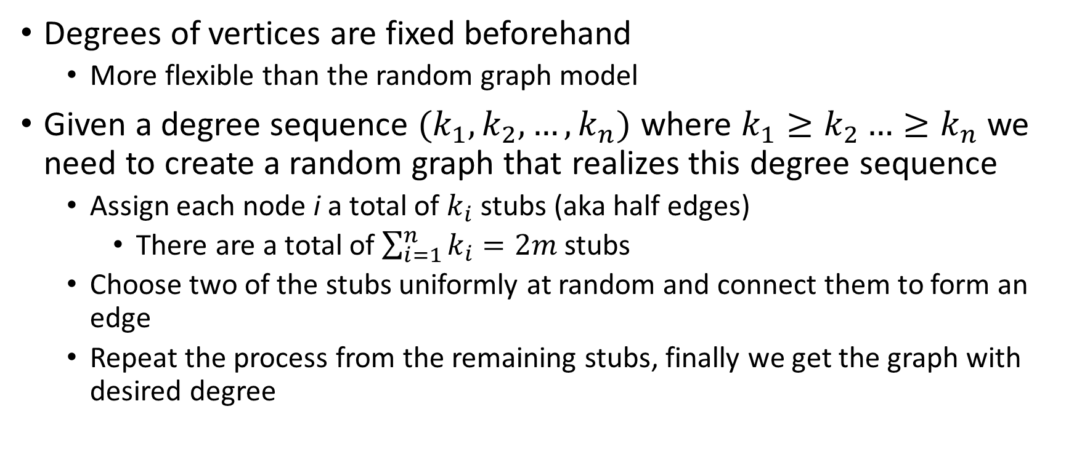
The configuration model
Degrees of vertices are fixed beforehand
More flexible than the random graph model
Given a degree sequence $(k_{1}, k_{2}, …, k_{n})$ where $k_{1}≥k_{2}…≥k_{n}$ we need to create a random graph that realizes this degree sequence
Assign each node i a total of $k_{i}$ stubs (aka half edges)
There are a total of $\sum_{i=1}^{n}{k_{i}}=2m$ stubs
Choose two of the stubs uniformly at random and connect them to form an edge
Repeat the process from the remaining stubs, finally we get the graph with desired degree

Slide 3
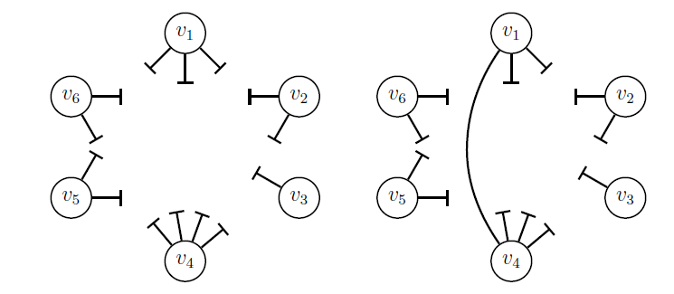
Configuration Model: Construction

Slide 4
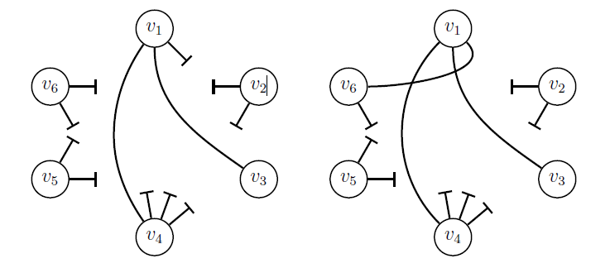
Configuration Model: Construction

Slide 5
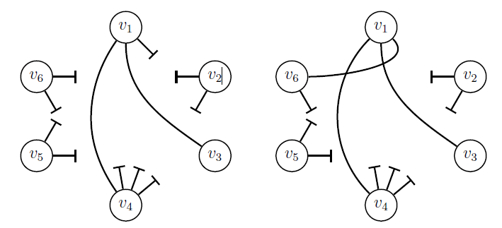
Configuration Model: Construction

Slide 6
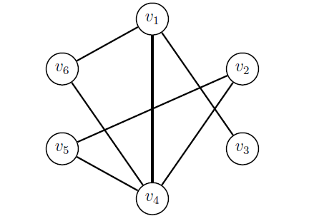
Configuration Model: Construction
The configuration model can be thought of as an ensemble of matching in which each matching with the chosen degree sequence appear with same probability
The process is then that of drawing networks from the configuration model ensemble

Slide 7
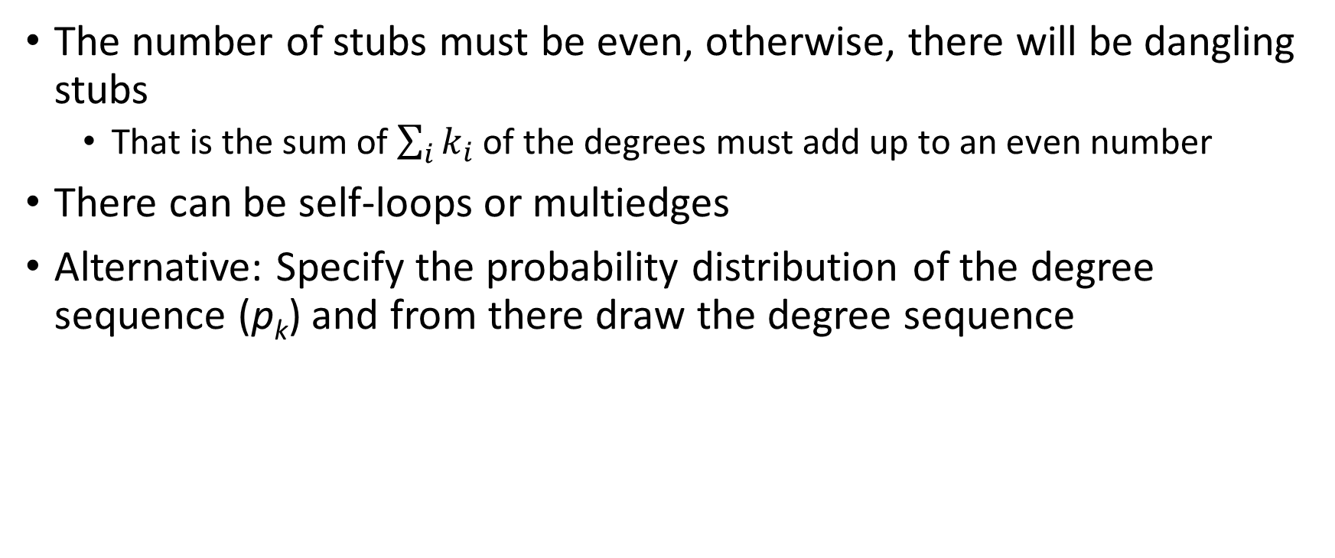
Configuration Model: Issues
The number of stubs must be even, otherwise, there will be dangling stubs
That is the sum of $\sum_{i}{k_{i}}$ of the degrees must add up to an even number
There can be self-loops or multiedges
Alternative: Specify the probability distribution of the degree sequence (p_{k}) and from there draw the degree sequence

Slide 8
In practice allow self-loop and multi-edges
Some real networks have such edges
Density of self edges and multiedges in the configuration model tends to zero in the limit of large n

Slide 9

Edge Probability
Probability of an edge between node i and j
$$p_{ij}=\frac{{k_{i}k}_{j}}{2m }$$
i
j

Slide 10
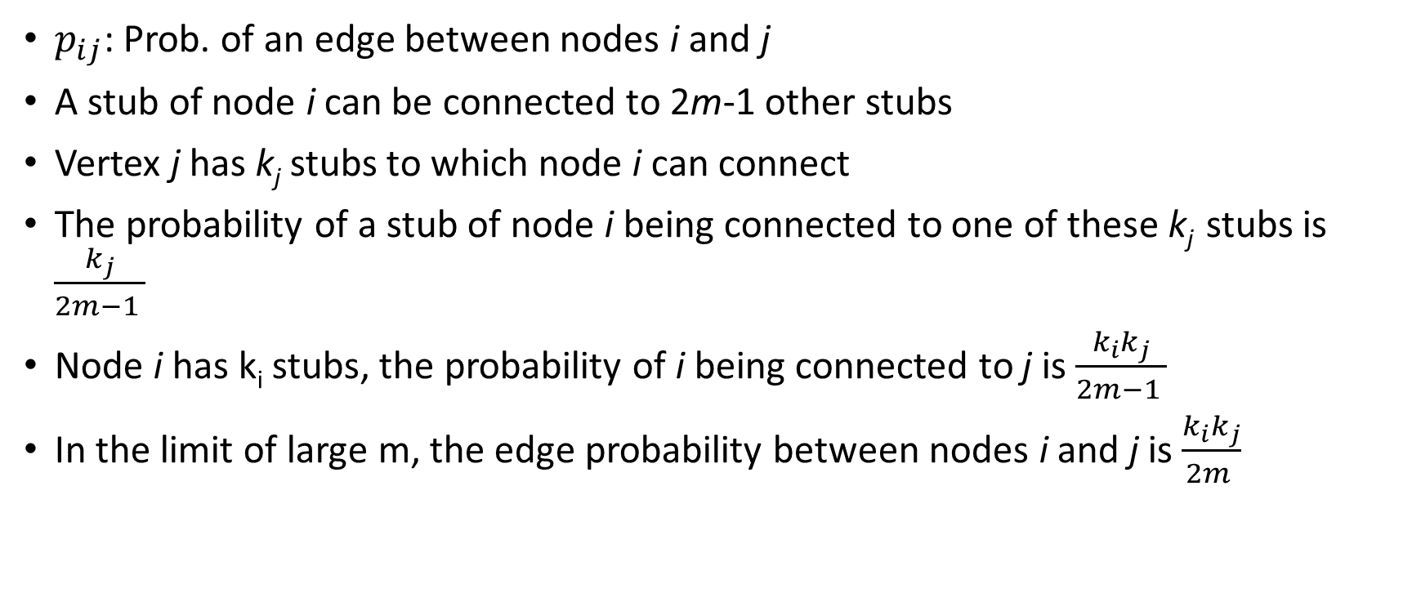
Edge Probability
$p_{ij}$: Prob. of an edge between nodes i and j
A stub of node i can be connected to 2m-1 other stubs
Vertex j has k_{j} stubs to which node i can connect
The probability of a stub of node i being connected to one of these k_{j} stubs is $\frac{k_{j}}{2m−1 }$
Node i has k_{i} stubs, the probability of i being connected to j is $\frac{{k_{i}k}_{j}}{2m−1 }$
In the limit of large m, the edge probability between nodes i and j is $\frac{{k_{i}k}_{j}}{2m }$

Slide 11
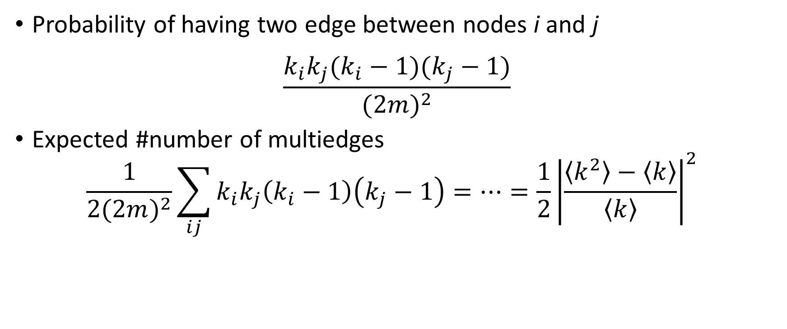
Multiedge Probablity
Probability of having two edge between nodes i and j
$$\frac{k_{i}k_{j}(k_{i}−1)(k_{j}−1)}{{(2m)}^{2}}$$
Expected #number of multiedges
$$\frac{1}{2{(2m)}^{2}}\sum_{ij}{k_{i}k_{j}\left(k_{i}−1\right)\left(k_{j}−1\right)=…=\frac{1}{2}{\left|\frac{\left\langle k^{2}\right\rangle −\left\langle k\right\rangle }{\left\langle k\right\rangle }\right|}^{2} }$$

Slide 12

Self loop probability
We will use the answer
$$p_{ij}=\frac{{k_{i}k}_{j}}{2m }$$
The only difference is probability of forming a self loop is not $k_{i}k_{j}$ but $\left(\begin{matrix}k_{i} \\ 2\end{matrix}\right)$
$p_{ii}=\frac{{k_{i}(k}_{i}−1)}{4m }$

Slide 13
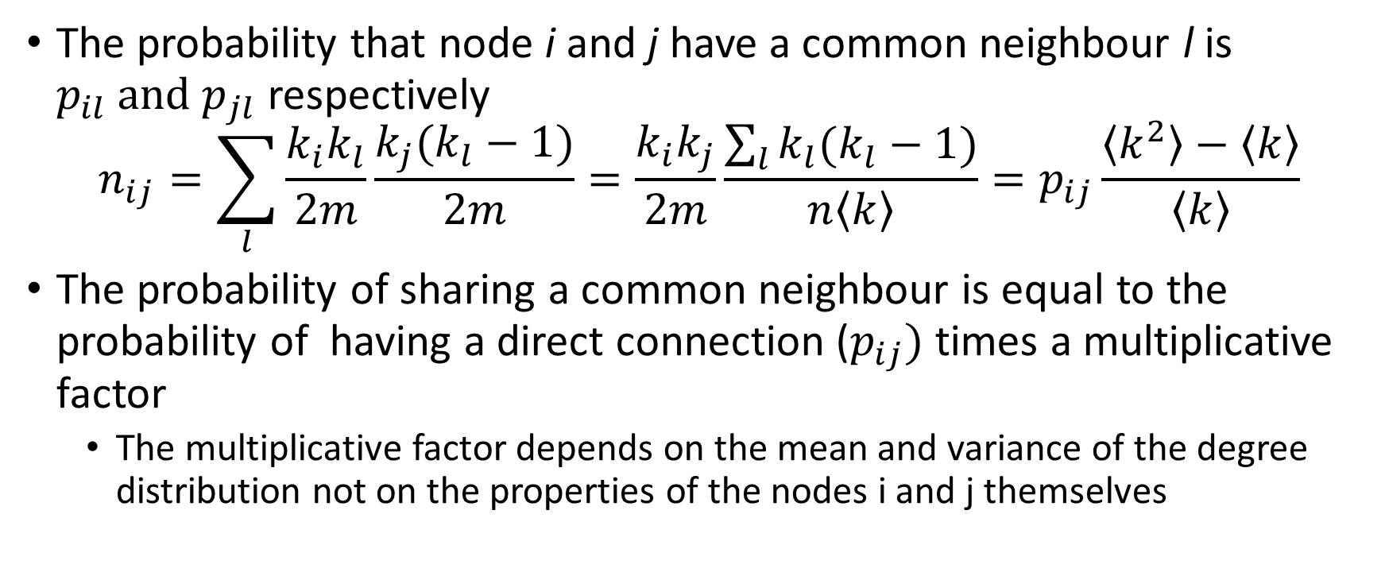
Expected common neighbours
The probability that node i and j have a common neighbour l is $p_{il} and p_{jl}$ respectively
$$n_{ij}=\sum_{l}{\frac{k_{i}k_{l}}{2m}\frac{k_{j}(k_{l}−1)}{2m}}=\frac{k_{i}k_{j}}{2m}\frac{\sum_{l}{k_{l}(k_{l}−1)}}{n\left\langle k\right\rangle }=p_{ij}\frac{\left\langle k^{2}\right\rangle −\left\langle k\right\rangle }{\left\langle k\right\rangle }$$
The probability of sharing a common neighbour is equal to the probability of having a direct connection ($p_{ij})$ times a multiplicative factor
The multiplicative factor depends on the mean and variance of the degree distribution not on the properties of the nodes i and j themselves

Slide 14
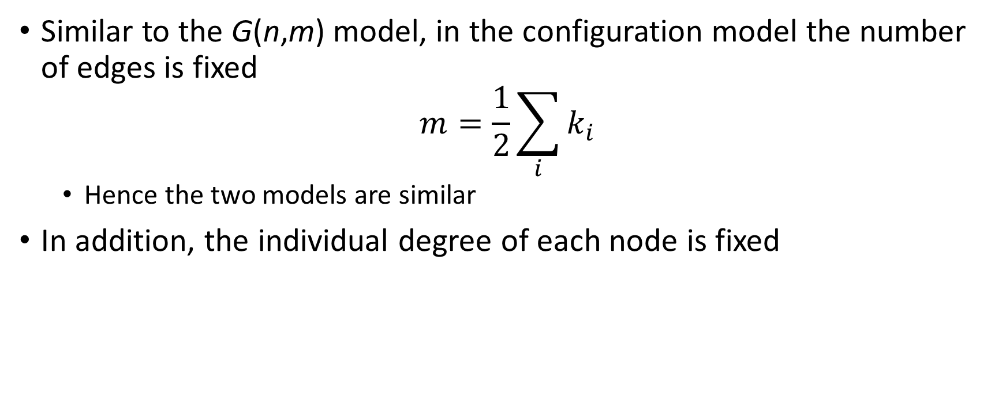
Configuration model vs. G(n,m)
Similar to the G(n,m) model, in the configuration model the number of edges is fixed
$$m=\frac{1}{2}\sum_{i}{k_{i}}$$
Hence the two models are similar
In addition, the individual degree of each node is fixed

Slide 15

Configuration model vs. G(n,p)
Fix a parameter c_{i} for each node and then place an edge as follows
$$p_{ij}=\left\{\begin{aligned}\frac{c_{i}c_{j}}{2m} for i≠j \\ \frac{c_{i}^{2}}{4m} for i=j\end{aligned}\right.$$
Now the #edges m is defined as $\sum_{i}{c_{i}=2m}$

Slide 16
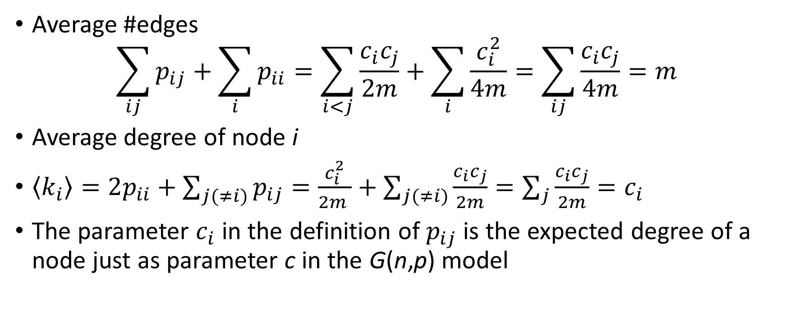
Configuration model vs. G(n,p)
Average #edges
$$\sum_{ij}{p_{ij}}+\sum_{i}{p_{ii}}=\sum_{i<j}{\frac{c_{i}c_{j}}{2m}+\sum_{i}{\frac{c_{i}^{2}}{4m}=\sum_{ij}{\frac{c_{i}c_{j}}{4m}=m}}}$$
Average degree of node i
$\left\langle k_{i}\right\rangle =2p_{ii}+\sum_{j(≠i)}{p_{ij}}=\frac{c_{i}^{2}}{2m }+\sum_{j(≠i)}{\frac{c_{i}c_{j}}{2m}=\sum_{j}{\frac{c_{i}c_{j}}{2m}=c_{i}}}$
The parameter $c_{i}$ in the definition of $p_{ij}$ is the expected degree of a node just as parameter c in the G(n,p) model

